Slide 1
About Programming
#2

Slide 2
Announcements
Starting next class (?) We will be doing programming! :D
If you want to write code along me, have your computers with you
During recitation, you will make sure you have Java installed and working
Let me know if you have issues
Recommended readings:
Chapter 1.1-1.4 of the Java book
Chapter 1 of https://www.cs.hmc.edu/~cs5grad/cs5book.pdf
This is a book about programming, they use Python, but the introduction is really interesting
I even took a couple of their examples ☺

Slide 3
Why do we want to program?
A programming language is a hammer
But it is only useful if we have a nail
We need a problem to solve!
So why do we program? Well, for many reasons. But mostly:
We want to automate a solution
We want to remove human error
And introduce computer error ;)
Computers are faster
Most people need computers to efficiently solve their problems
Analyse data, track the status of machines, solve complex maths, store large volumes of data, simulate and model complex systems (how do chemicals react)

Slide 4
Can computers solve anything?
Nope

Slide 5
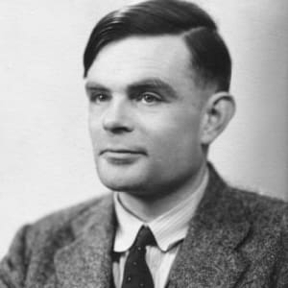
Alan Turing - Father of Computer Science
Alan Turing (1912-1954)
Mathematician and cryptanalyst.
Devised the scheme that broke the Enigma code in World War II
Bombe
Published a thesis that provided a model of a computational machine
The Turing Machine

Slide 6
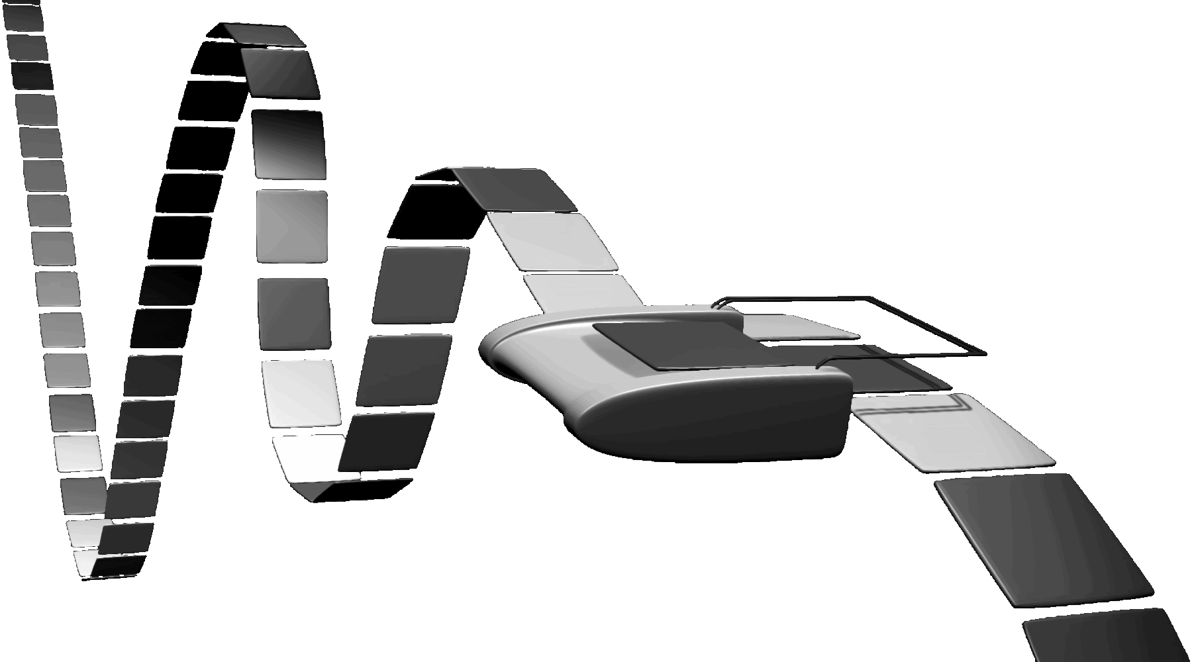
The Turing machine
Has infinite memory represented by a single tape.
A head moves along the tape and can read and write values.
The movement (left or right) is based upon the value read and the state of the machine.
Over simplified definition of state: A rulebook ☺
A general, formal description of a computer.
Theoretical and simple: all physical machines live up to this formal description.
Rulebook 1
Rulebook 20
Read | Write | Move | Next
0 | 1 | ← | 20
1 | 0 | → | 12
Read | Write | Move | Next
0 | 0 | → | 15
1 | 1 | → | 15
➔

Slide 7
The Turing machine
The Turing machine performs terribly
But it models the behaviour of every modern machines
Models: Simulates the behaviour of something. Often by abstracting details.
The machine reads data, compares that data to make a decision:
what data is written and
which direction it moves the head
Everything that can be computed, is computed by a Turing machine
Turing-complete: Can do anything a Turing machine can do
So, can we use a Turing machine to simulate a Turing machine
Well, yes we can!
(Puts tin-foil hat on)

Slide 8
Will it stop?
But can everything be computed?
E.g.: Can we even prove for any program if it’ll halt (stop)?
Turing proved that no, we cannot do that:
Are There Problems That Computers Can't Solve?
https://www.youtube.com/watch?v=eqvBaj8UYz4
Thanks Tom Scott for the perfect timing ☺
So there are some problems that computers cannot solve
But in this course, we’ll focus on those it can solve

Slide 9
And programming languages?
Programming languages model this theoretical machine not the physical machine.
They assume infinite memory!
But you only have to guarantee that you have enough!
They assume infinite time!
The programmer, not the language, imposes and considers any extra limitations.
When we hit the limitations of the physical machine it crashes ☹
Most (all) Programming languages are Turing-complete
Programming languages can compute anything computable

Slide 10
Algorithms
Delicious recipies!

Slide 11
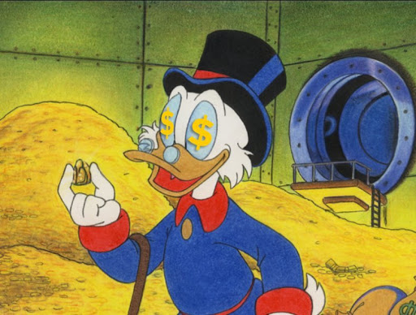
Solving problems
Presented with a computational problem, we need to find a solution
An Algorithm: A sequence of steps that carry out a task.
E.g. order your music collection by album, find webpages using the keywork “pumpkin pie”
The shampoo algorithm
Lather
Rinse
Repeat

Slide 12
The shampoo algorithm – better!
The shampoo algorithm
Lather
Rinse
Repeat 1→2
Here are the basics of the Turing machine
States
What are we doing now?
Read/write
Read (check status of hair)
Write (put on shampoo)
Make decisions
Do we repeat?
The shampoo algorithm
Lather
Rinse
Repeat until clean

Slide 13
Different hammers for different nails
Problems usually have several correct solutions ➔ different algorithms
Some are faster, some are smaller (less steps)
Some are better, some are worst
Is faster/smaller better or worst?
They are often compared to recipes
Ingredients → data
Pumpkin pie recipe from https://www.cs.hmc.edu/~cs5grad/cs5book.pdf
→ We’ll discuss this later ☺
Mix 3/4 cup sugar, 1 tsp cinnamon, 1/2 tsp salt, 1/2 tsp ginger and 1/4 tsp cloves in a small bowl.
Beat two eggs in a large bowl.
Stir 1 15-oz. can pumpkin and the mixture from step 1 into the eggs.
Gradually stir in 1 12 fl. oz. can evaporated milk into the mixture.
Pour mixture into unbaked, pre-prepared 9-inch pie shell.
Bake at 425◦F for 15 minutes.
Reduce oven temperature to 350◦F.
Bake for 30–40 minutes more, or until set.
Cool for 2 hours on wire rack.
Assuming we know how to measure, crack eggs, stir, etc.

Slide 14
Computer algorithms are not much different
Let’s replace Pie by π
Example also from https://www.cs.hmc.edu/~cs5grad/cs5book.pdf
Draw a square that is 2 by 2 feet.
Inscribe a circle of radius 1 foot (diameter 2 feet) inside this square.
Grab a bucket of n darts, move away from the dartboard, and put on a blindfold.
Take each dart one at a time and for each dart:
With your eyes still covered, throw the dart randomly (but assume that your throwing skills ensure that it will land somewhere on the square dartboard).
Record whether or not the dart landed inside the circle.
When you have thrown all the darts, divide the number that landed inside the circle by the total number, n, of darts you threw and multiply by 4. This will give you your estimate for π.
(Please don’t try this at home)

Slide 15
Programming languages

Slide 16
Implementing algorithms
To implement an algorithm we write a program
Algorithm: The list of instructions
Program (code): The software. Implementation of the algorithm
And we need to learn a programming language
Programming language: The vocabulary and syntax rules.
We’ll use Java. But the ideas are transferable to other programming languages.
Why Java?
1 → Java is a High-Level Language!
2 → Java is portable

Slide 17

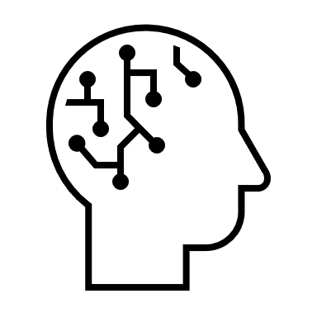
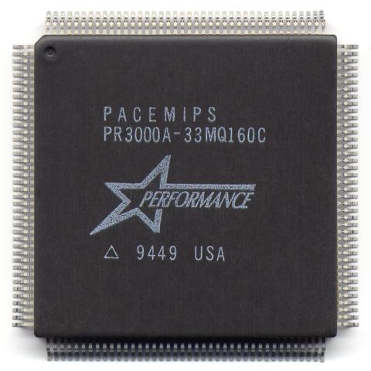
Different language levels
x=x+1
High-level language
Written by humans → Abstracted
Easier to read
Closer to the hardware
lw $t0, x addi $t0, $t0, 1 sw $t0, x
Assembly language
Written by humans→ No abstraction
10011101100110011001111101111001 11011110110010111011101001111001
10011100100110110001101111111011
Random numbers ☺
Machine language
Spoken by the CPU→ Binary

Slide 18
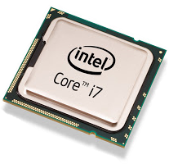
Different language levels
x=x+1
High-level language
→ Same for different CPUs
lea x, %eax
mov 0(%eax), %ecx
inc %ecx
mov %ecx, 0(%eax)
lw $t0, x addi $t0, $t0, 1 sw $t0, x
Assembly language
→ Different for different CPUs
0100111101111001000110110010111001111011001011100110101101001111011110010001101100101110
100111011001100110011111011110011101111011001011101110100111100110011100100110110001101111111011
Random numbers ☺
Random numbers ☺
Machine language
→ Different for different CPUs

Slide 19
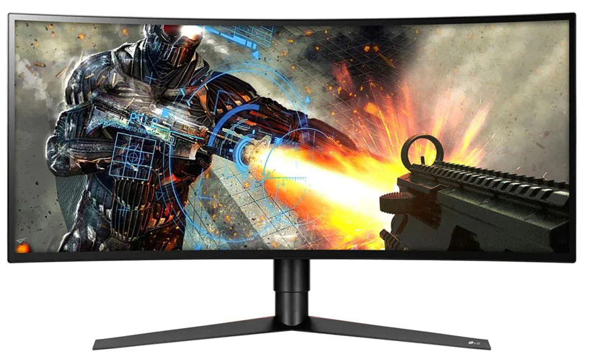
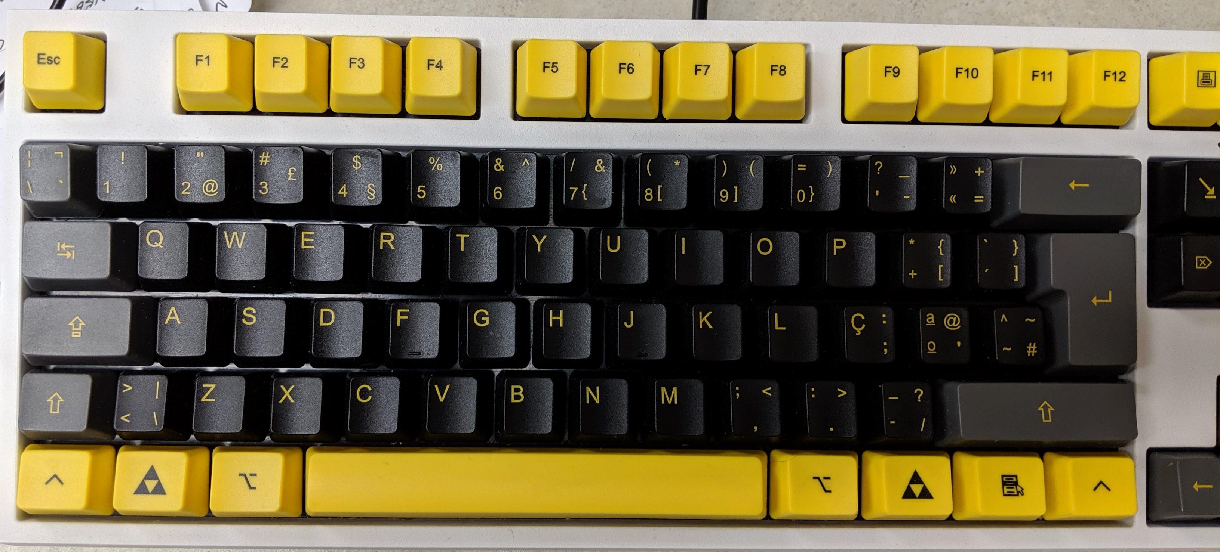
Different platforms
Run Hello.exe
Run Hello.exe
Run Hello.exe
I don’t recognize that!
Let’s go!
What is that inferior format?
Linux
Windows
MacOS

Slide 20
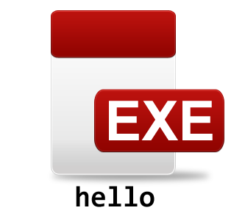
Some languages are compiled
Run this!
OK!
Compiler MIPS + Linux
C++
Run this!
Nope!
Source Code
Executable
converts C++ code to machine code
Compiler Intel + windows
Run this!
OK!
Need different compilers for each platform ☹
Executable

Slide 21



Some languages are interpreted
Run this!
Interpreter
Ruby
Source Code
Reads code and translates to the CPU language on the fly!
Interpreter

Slide 22
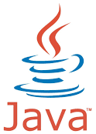


Some languages are compiled and interpreted
Compiler Java (javac)
JAVA Bytecode
Java
Intermediate Language Code
Source Code
converts Java code to a fake machine code
Java executable.
Can be distributed to all
Run this!
Interpreter
Java Virtual Machine (JVM)

Slide 23
What’s the big deal
Run Hello.jar
Run Hello.jar
Run Hello.jar
Developer compiles
Let’s go!
Let’s go!
Let’s go!
Linux
Windows
MacOS
User installs interpreter

Slide 24
Picobot
Let’s start programming :D

